Slide 1

QUANTUM UNLEASHED
Beyond Classical Limits
Presented by Sougata

Slide 2

What is Quantum?
▸ New computational paradigm
▸ Harnesses quantum mechanics
▸ Solves impossible problems
2
Notes:
We are entering a new era of computing, one that moves beyond the classical bits of 0s and 1s. Quantum computation leverages the strange rules of quantum mechanics to tackle problems previously considered intractable.

Slide 3
Qubits: New Bits
▸ Superposition: states simultaneously
▸ Not just 0 or 1
▸ Exponential information density
3
Notes:
At the heart of quantum computing are qubits. Unlike classical bits, qubits can exist in a superposition of both 0 and 1 at the same time, allowing for a massive increase in information storage and processing capability.

Slide 4

Entanglement: Connected
▸ Quantum link, instant influence
▸ Spooky action at distance
▸ Powerful computational resource
4
Notes:
Entanglement is another mind-bending quantum phenomenon where two or more qubits become linked, sharing the same fate regardless of distance. This 'spooky action' is a crucial resource for quantum algorithms.

Slide 5
Interference: Probabilities
▸ Amplify correct answers
▸ Cancel incorrect ones
▸ Guiding quantum paths
5
Notes:
Quantum interference allows us to manipulate the probabilities of different outcomes. By carefully constructing algorithms, we can amplify the probability of correct solutions while diminishing incorrect ones, effectively guiding the quantum system to the right answer.

Slide 6
Algorithm Breakthroughs
▸ Shor's: Factor large numbers
▸ Grover's: Search databases fast
▸ Unlocks new capabilities
6
Notes:
Early quantum algorithms like Shor's and Grover's demonstrated the immense potential. Shor's algorithm could break modern encryption, and Grover's could significantly speed up database searches, showcasing quantum's disruptive power.

Slide 7
Transformative Applications
▸ Drug discovery, materials
▸ Financial modeling, AI
▸ Optimize complex systems
7
Notes:
The applications of quantum computing span across numerous fields. From simulating complex molecules for new drugs and materials to optimizing financial models and enhancing AI, its impact will be profound.

Slide 8

Hurdles & Horizon
▸ Decoherence: fragile states
▸ Error correction needed
▸ Building scalable systems
8
Notes:
Despite its promise, quantum computing faces significant challenges. Qubits are fragile and prone to decoherence, requiring sophisticated error correction. Building stable, large-scale quantum computers remains a monumental engineering task.

Slide 9
Future Unlocked
▸ Revolutionary computing era
▸ Redefine problem-solving
▸ Shape our future
9
Notes:
Quantum computation promises to usher in a truly revolutionary era, redefining what's possible in science, technology, and industry. It will fundamentally change how we approach the most complex problems facing humanity.

Slide 10
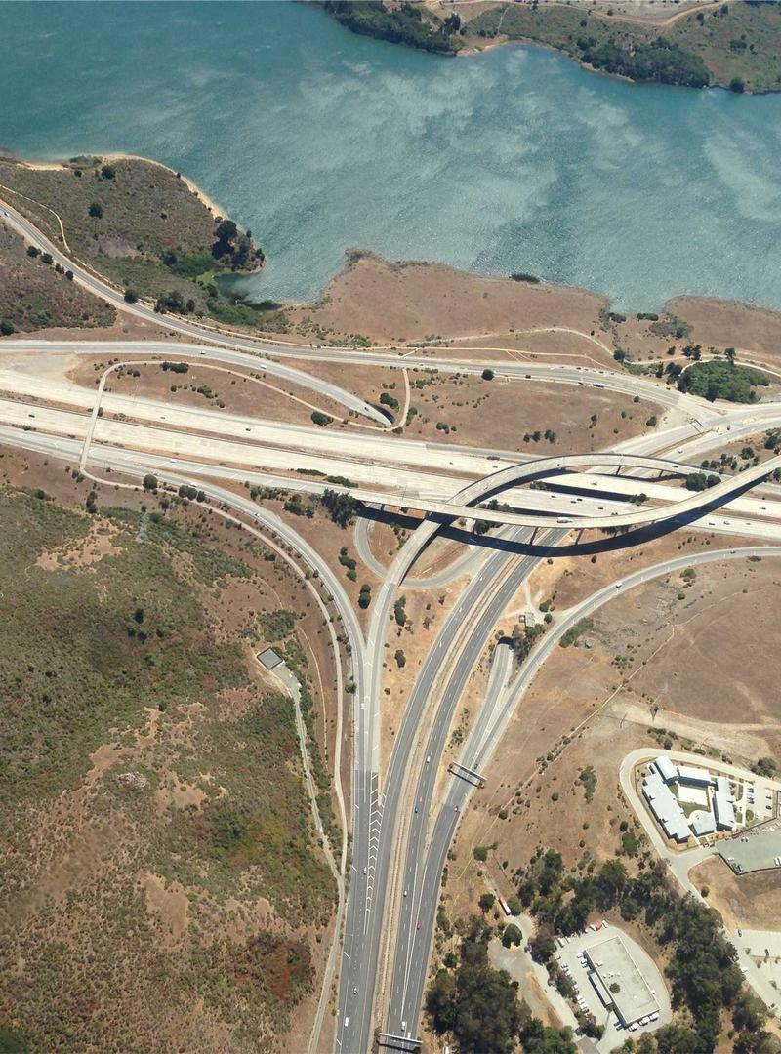
Questions?
10
Notes:
Thank you for your attention. I'm happy to answer any questions you might have about quantum computation.

